Slide 1
Module 4 Basic Query Formulation with SQL
Lesson 2: SELECT Statement Introduction
Notes:
Welcome to lesson 2 of Module 4 on basic query formulation with SQL
Query formulation is an important skill in application development.
Everyone involved in the application development must be competent in query formulation.
Most students will be involved (at least initially) in application development rather than in a role as a database specialist. Database specialists must also understand query formulation and SQL.
Opening question:
What database details should you know before you try to formulate a query?
When should you use parentheses in writing conditions to limit rows?

Slide 2
Lesson Objectives
Write SQL SELECT statements involving row conditions on single tables
Execute SELECT statements
Write and execute practice problems
Notes:
Write SELECT statements without using a visual tool
Execute using Oracle or MySQL
Need extra practice

Slide 3
SELECT Statement Overview
SELECT <list of column expressions>
FROM <list of tables and join operations>
WHERE <list of logical expressions for rows>
ORDER BY <list of sorting specifications>
Column expression: combination of columns, constants, operators, and functions
FacSalary * 1.1
Logical expression: conditions connected by AND, OR, and NOT
OffTerm = 'FALL' AND OffYear = 2012
Notes:
Simple syntax omits important parts such as GROUP BY clause. Will add to syntax in later lessons.
Conventions:
- Upper case: keywords
- Angle brackets: supply data
Expression examples: annotate during lecture
- StdFirstName: student first name
- FacSalary * 1.1 : inflate salary by 10%
Logical expression:
- T/F value
- AND, OR, NOT

Slide 4
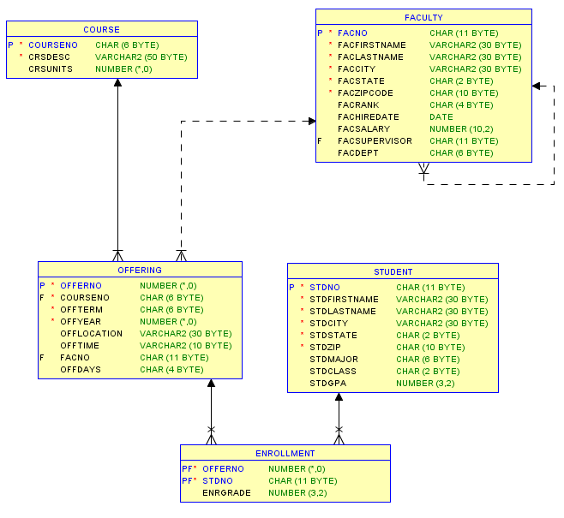
University Database Diagram
Notes:
Use university database for examples
University database was covered in previous modules so you should be familiar with it.
The problems in this lesson just involve single tables so understanding relationships is not important.

Slide 5
First SELECT Examples
Example 1
SELECT * FROM Faculty;
Example 2
SELECT *
FROM Faculty
WHERE FacNo = '543-21-0987';
Example 3
SELECT FacFirstName, FacLastName, FacSalary
FROM Faculty
WHERE FacSalary > 65000 AND FacRank = 'PROF';
Example 4
SELECT FacCity, FacState
FROM Faculty;
SELECT DISTINCT FacCity, FacState
FROM Faculty;
Notes:
Example 1:
- Retrieves all rows and columns
- * in the SELECT clause evaluates to all columns of the FROM tables
Example 2:
- Retrieves a single faculty row (subset of rows)
- Oracle: use hyphens in FacNo constant (543-21-0987)
Example 3:
- Retrieves a subset of rows and columns
- Oracle is case sensitive on string constants (PROF).
- In MySQL, case sensitivity depends on the character set used when a table is created.
Example 4:
Retrieves city and state of faculty
Duplicate rows in the result because faculty many faculty live in the same city and state
Use DISTINCT to eliminate duplicate rows

Slide 6
Using Expressions
Example 5 (Oracle)
SELECT FacFirstName, FacLastName, FacCity,
FacSalary*1.1 AS IncreasedSalary,
FacHireDate
FROM Faculty
WHERE to_number(to_char(FacHireDate, 'YYYY')) > 2001;
Example 5 (MySQL)
SELECT FacFirstName, FacLastName, FacCity,
FacSalary*1.1 AS IncreasedSalary,
FacHireDate
FROM Faculty
WHERE (date_format(FacHireDate, '%Y')) > 2001;
Notes:
Example 5:
- Retrieves faculty hired after 2001
- Inflates salary by 10%
Use expressions instead of just column names
Specifying result columns following the SELECT keyword
Specifying conditions in the WHERE clause
Different functions by DBMS: need to carefully study documentation

Slide 7
Inexact Text Matching
Use LIKE operator to match against a pattern
Use meta characters to specify patterns
Wildcard (%)
Any single character (_)
Example 6
SELECT *
FROM Offering
WHERE CourseNo LIKE 'IS%';
Notes:
Common patterns:
- Strings with specified endings
- Strings with specified beginnings
- Strings containing a substring
Meta characters:
- Special meaning when using the LIKE operator
- Many others available: study DBMS documentation
Example 6:
- Retrieves offerings of IS course numbers

Slide 8
Using Date Constants
Dates are numbers
Date constants and functions are not standard
Example 7 (Oracle)
SELECT FacFirstName, FacLastName, FacHireDate
FROM Faculty
WHERE FacHireDate BETWEEN '1-Jan-2004'
AND '31-Dec-2005';
Example 7 (MySQL)
SELECT FacFirstName, FacLastName, FacHireDate
FROM Faculty
WHERE FacHireDate BETWEEN '2004-01-01'
AND '2005-12-31';
Notes:
Date manipulation:
- Not strings: do not use pattern matching characters even though some DBMSs permit
(not portable)
- Study documentation carefully for date functions and constant formats
BETWEEN-AND operator:
- Closed interval (includes end points)
- Short cut for >= AND <=
- No shortcuts for other intervals

Slide 9
Combining Conditions
Example 8: Testing for null values
SELECT OfferNo, CourseNo
FROM Offering
WHERE FacNo IS NULL AND OffTerm = 'SUMMER'
AND OffYear = 2013;
Example 9: Mixing AND and OR
SELECT OfferNo, CourseNo, FacNo
FROM Offering
WHERE (OffTerm = 'FALL' AND OffYear = 2012)
OR (OffTerm = 'WINTER' AND OffYear = 2013);
Notes:
Combine conditions with logical operators
AND: row must satisfy all conditions
OR: row must satisfy at least one condition
Use parentheses when mixing AND/OR
Example 8:
- Retrieve summer 2013 offerings without an assigned instructor
- Use IS NULL to test for null values
Example 9:
- Retrieve offerings in Fall 2012 or Winter 2013
-Always use parentheses when mixing AND and OR
- Reader may not know default evaluation
- Easy to make a mistake
- May not be portable if parentheses are not used

Slide 10
Summary
Subset of the SELECT statement
Background about database details essential for query formulation
Lots of practice to master query formulation and SQL
Notes:
SELECT statement subset
SELECT clause with result columns
FROM clause with just one table
WHERE clause with conditions on numeric, text, and date columns
Know tables and relationships with the help of a database diagram before formulating queries. In this lesson, you should know the column names and data types (numeric, text, or date).
Lots of practice
- Work many problems without seeing the solutions
- 50 problems to develop understanding of query formulation and SQL
- Do not rely on visual query tools; use SQL directly

